Slide 1
Latin Hypercube Sampling
Uncertainty quantification in machine learning
Mridul Varghese Koshy
22963
MSc Data Science

Slide 2
Overview
Introduction
Monte Carlo Simulation
Latin Hypercube Sampling
Sample Generation
Sample Ordering
Poisson process simulation results
Conclusion

Slide 3
Introduction
Sampling is the process by which values are randomly taken from input probability distributions.
There are several different ways in which a probability sample can be selected. Eg: Simple Random Sampling, Systematic Random Sampling, Stratified Random Sampling, etc.
Choosing a sampling method affects both the quality of the result and the length of simulation time.

Slide 4
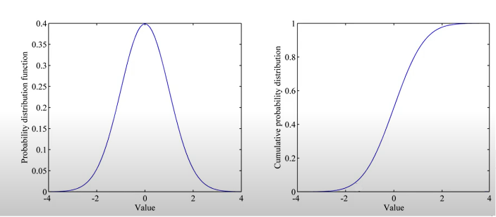
Cumulative Probability Distribution
Any probabilistic distribution may be expressed in its cumulative form.
Source: Moazzen,Iman. “Latin Hypercube Sampling” 05 Apr 2016 , University of Victoria

Slide 5
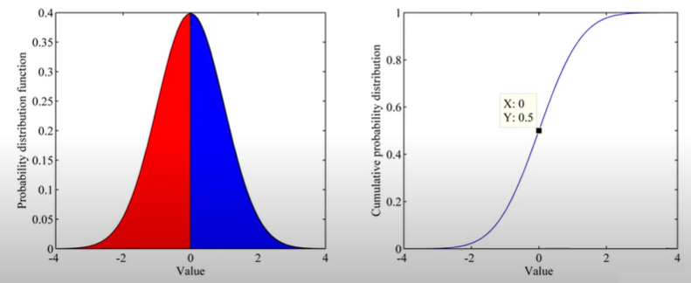
Cumulative Probability Distribution
Any probabilistic distribution may be expressed in its cumulative form.
Source: Moazzen,Iman. “Latin Hypercube Sampling” 05 Apr 2016 , University of Victoria

Slide 6
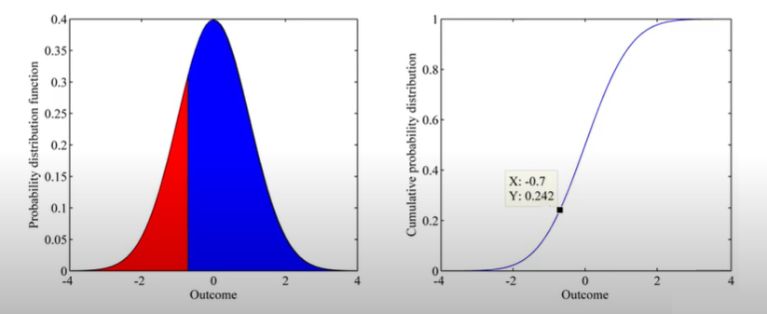
Cumulative Probability Distribution
Any probabilistic distribution may be expressed in its cumulative form.
Source: Moazzen,Iman. “Latin Hypercube Sampling” 05 Apr 2016 , University of Victoria

Slide 7
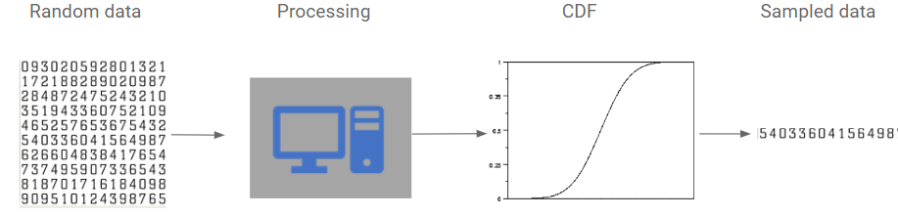
Monte Carlo Simulation
Monte Carlo simulation is a computerized mathematical technique for generating random sample data based on some known distribution for numerical experiments.

Slide 8
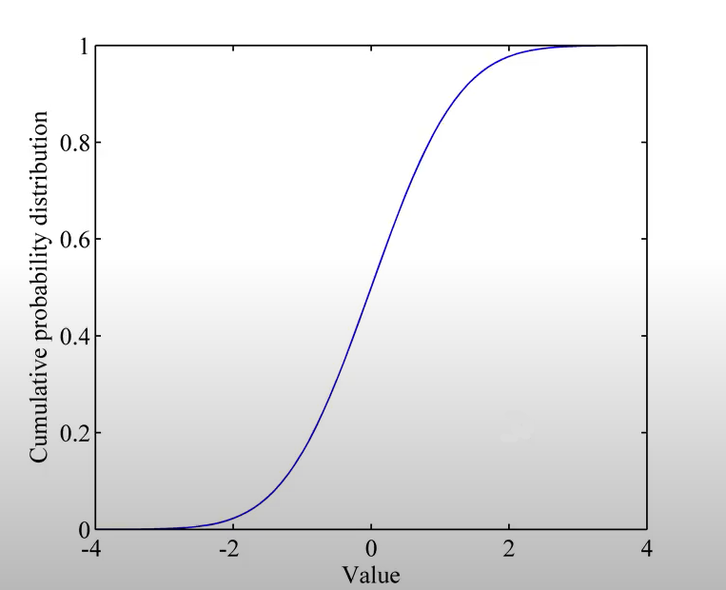
Monte Carlo Simulation
For each sample, the computer will generate a random variable between 0 and 1.
The number will be assigned to a value using cumulative probability distribution.
Each sample is entirely random:
sample can be taken from anywhere within the range of input distribution.
Memoryless approach
Large number of samples are required

Slide 9
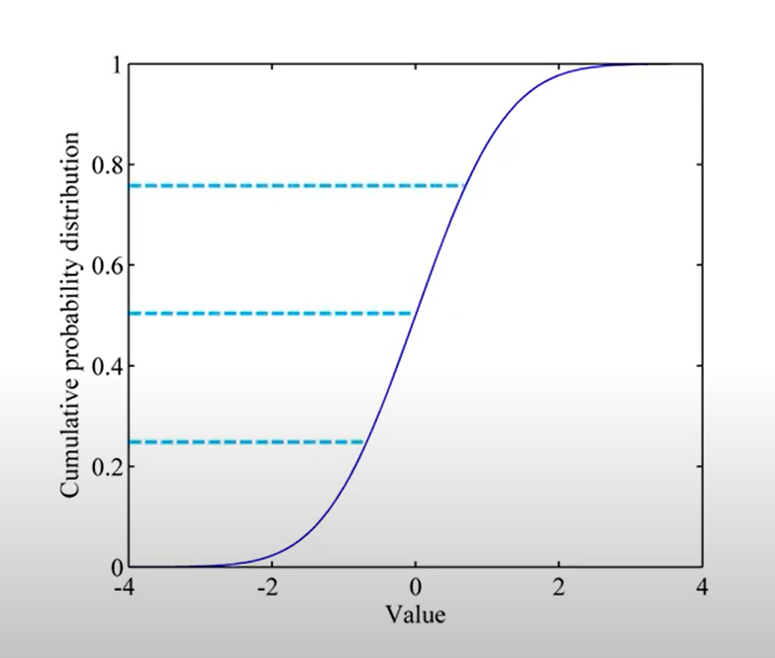
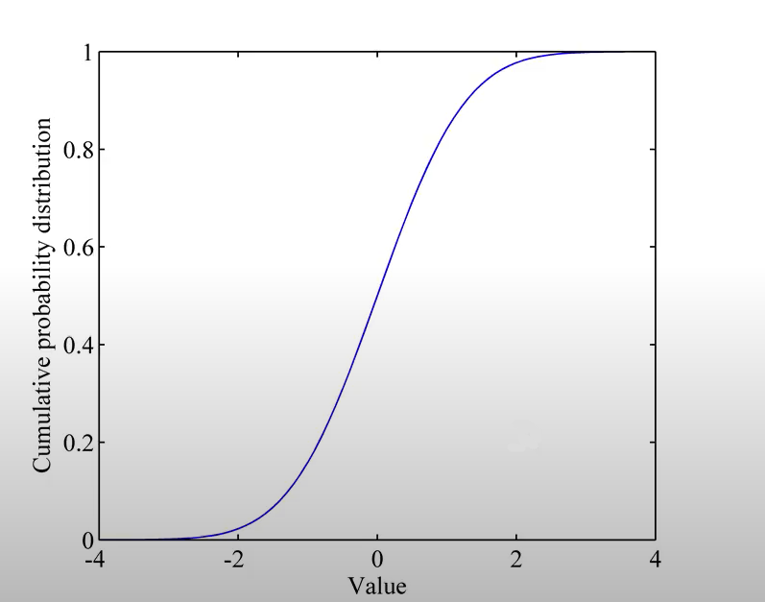
Latin Hypercube Sampling
One of the best small-sample Monte Carlo method
Less samples required for recreating the input distribution
Stratification: divides the cumulative curve into equal intervals
Only one sample per stratification chosen randomly

Slide 10
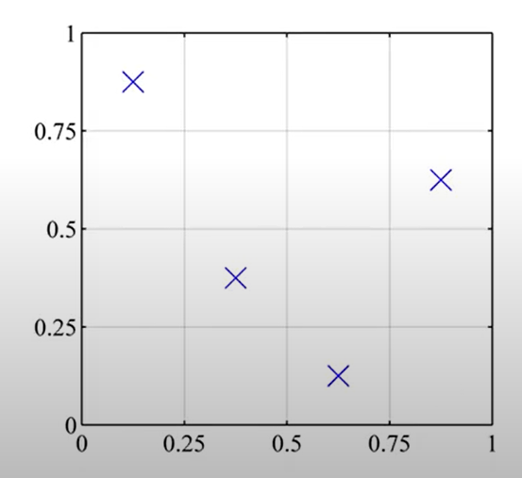
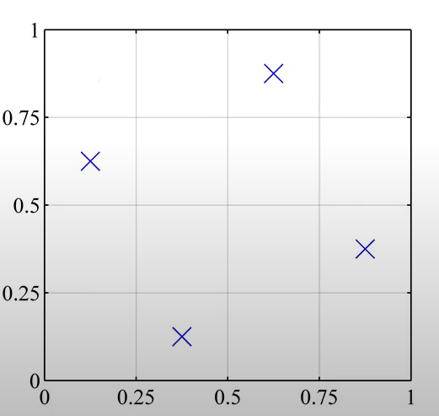
Latin Hypercube Sampling (Two Dimensions)
Latin Square: only one sample in each row or each column
Notes:
Latin square is a square grid with sample positions such a way that their can be only one sample in each row or each column.
Latin Hypercube is a generalization of this concept where in which each sample is the only one in each axis aligned hyperplane containing it.

Slide 11
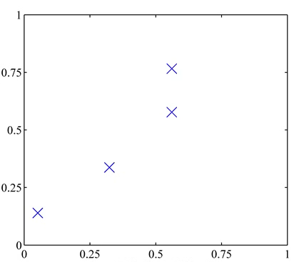
Monte Carlo vs Latin Hypercube
Monte Carlo: New samples are generated without taking into account the previously generated points. (Memoryless)
Latin Hypercube: New samples are generated taking into account the previously generated points. (Memory based)

Slide 12
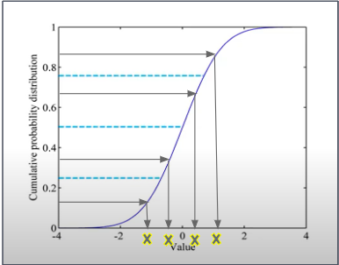
Sample Generator
First stage in Latin Hypercube
Divide variable into equal intervals
One sample is taken from each interval

Slide 13
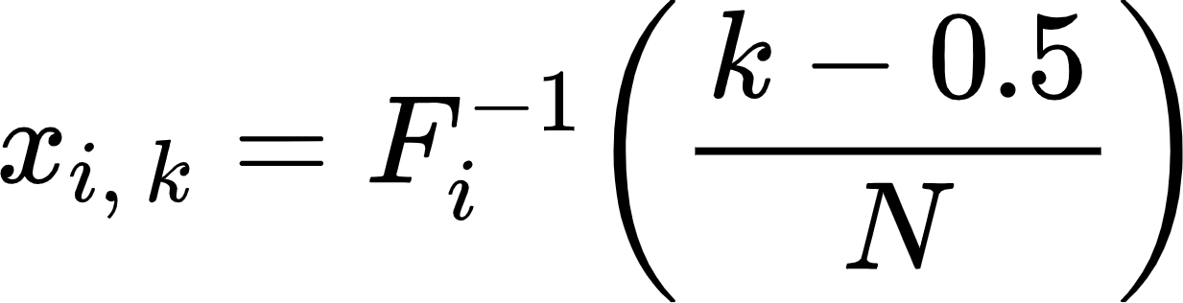
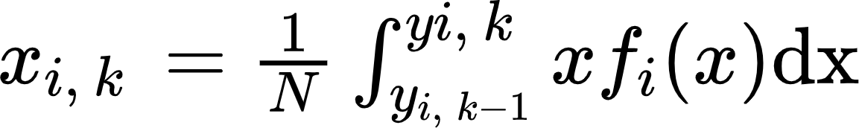
Sample Generator
Standard practice: choose samples from the cumulative distribution function
Proposed improvement: choose random mean of each section

Slide 14
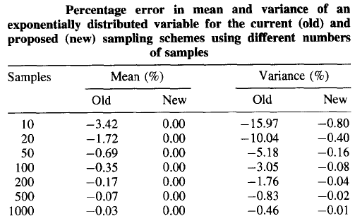
Sample Generator
Advantages(proposed method)
Better mean and variance of the simulated variable
Increased statistical accuracy
Disadvantages(proposed method)
Time consuming
Increased resource utilization
Source: D. E. Huntington, C. S. Lyrintzis. Improvements to and limitations of Latin hypercube sampling. 1998 San Diego State University, San Diego

Slide 15

Sample Ordering
Second stage of Latin Hypercube
WHY?
Cause for significant correlation between some variable when samples generated are ordered randomly

Slide 16
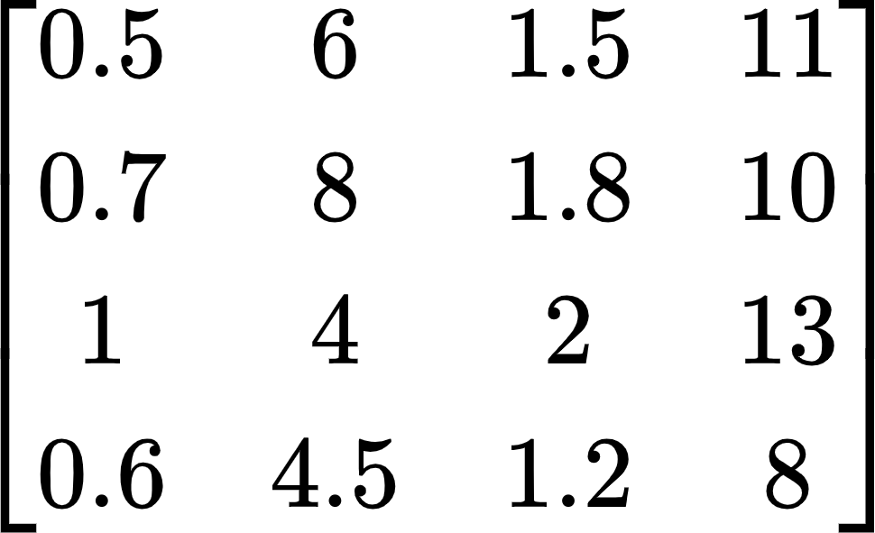
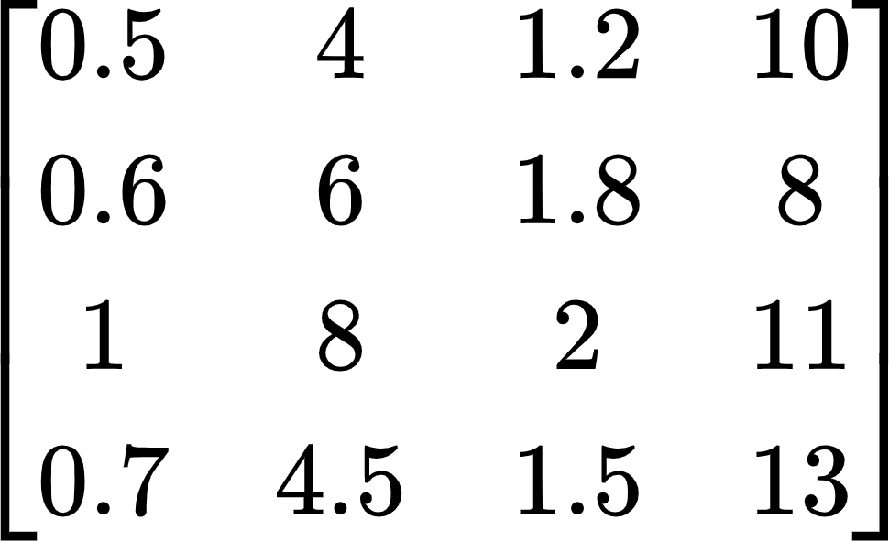
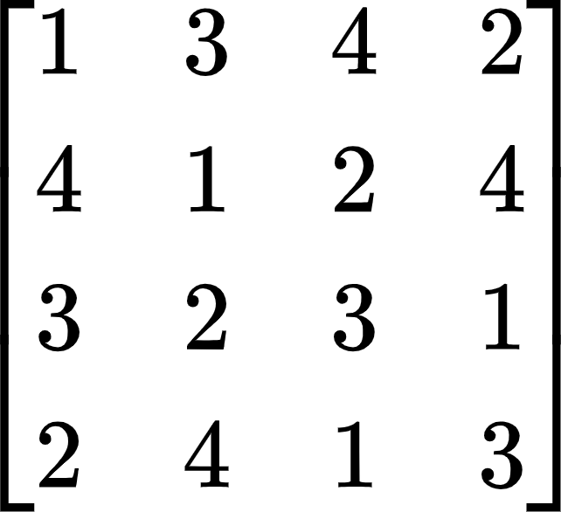
Sample Ordering
Solution:
Rank numbers are used in ordering scheme
An ordering matrix R is formed with columns containing permutation of rank numbers for each variable
Samples for each variable are arranged based on the ordering matrix using rank numbers
nth reordered sample is used for the nth output
Unordered samples
Ordered samples
Ordering matrix R
Notes:
The rank numbers are the values of k used to generate samples

Slide 17
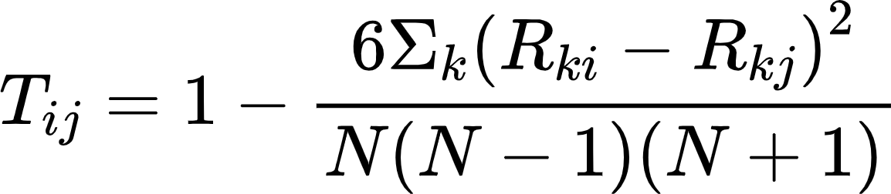
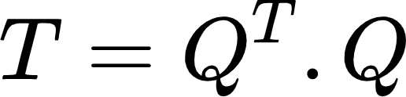
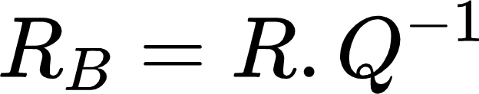
Sample Ordering
Problems to consider
No two columns should be alike
Correlation between two columns in the ordering matrix are defined by Spearman correlation coefficients
T_{ij} is the Spearman correlation coefficient between variable i and j
Correlation matrix T is symmetric and positive definite
Cholesky decomposition is performed on matrix T:
Pseudo-ordering matrix R_{B} is generated:
Ordering matrix R is rearranged to have the same ordering as R_{B}

Slide 18
Sample Ordering
Disadvantages:
Although low correlations are expected between the variables, ordering will still produce results with significant correlation errors between some variables.
Correlation process may only be performed once, hence no iteration is possible.
Notes:
New ordering matrix does not allow the variables to match target correlation
coefficients well, nothing can be done to rectify the
problem.

Slide 19
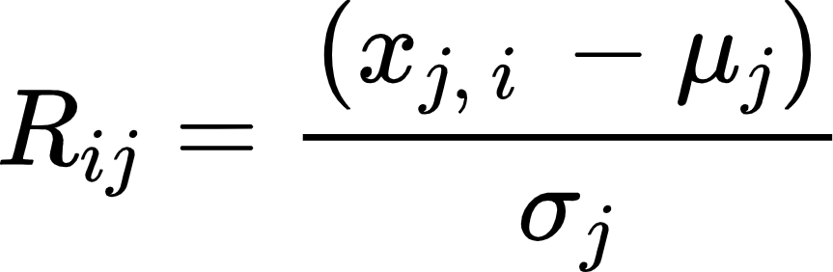


Sample Ordering
Proposed improvement:
Single-switch-optimized sample ordering scheme
New matrix R is generated : , is the mean of jth variable and is the standard deviation for that variable.
Transformation ensures matrix R has zero mean for each column and unit-variance variable.

Slide 20
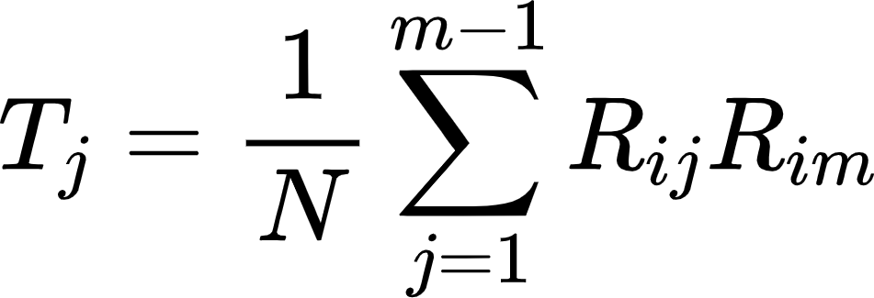
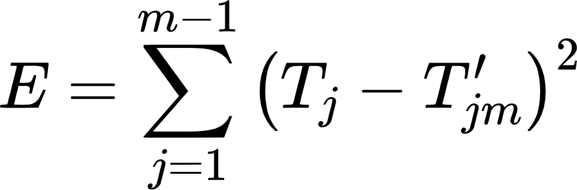
Sample Ordering
mth column ordering:
Calculate vector T, containing correlation coefficients between mth column and each of its previous columns
, where 1 ≤ j ≤ m - 1
Error E in the correlation coefficient is defined as: where T’ is the matrix containing target coefficient correlation.

Slide 21
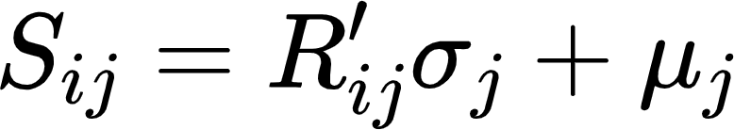
Sample Ordering
The change in E is calculated for each pair of samples in the mth column if samples were switched.
The pair with the greatest reduction in E are then switched.
The process is repeated for the mth variable until no improvement is possible or until all correlation coefficients are within defined thresholds.
The process is repeated for other variables one at a time to generate new ordered matrix R’.
Ordered sample can be expressed in matrix S:

Slide 22
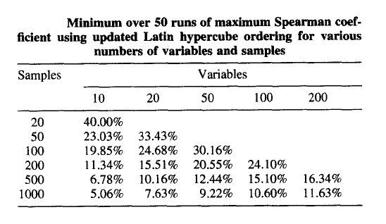
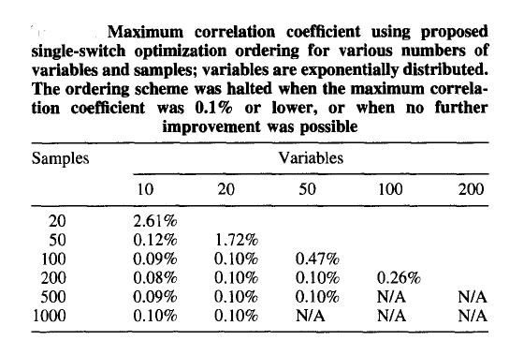
Sample Ordering
Updated Latin Hypercube ordering vs Single-switch optimization ordering
Source: D. E. Huntington, C. S. Lyrintzis. Improvements to and limitations of Latin hypercube sampling. 1998 San Diego State University, San Diego

Slide 23
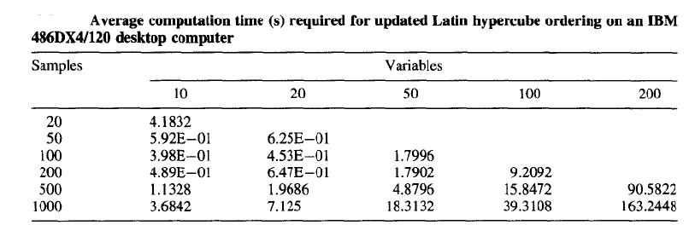
Sample Ordering
Updated Latin Hypercube ordering vs Single-switch optimization ordering
Source: D. E. Huntington, C. S. Lyrintzis. Improvements to and limitations of Latin hypercube sampling. 1998 San Diego State University, San Diego

Slide 24
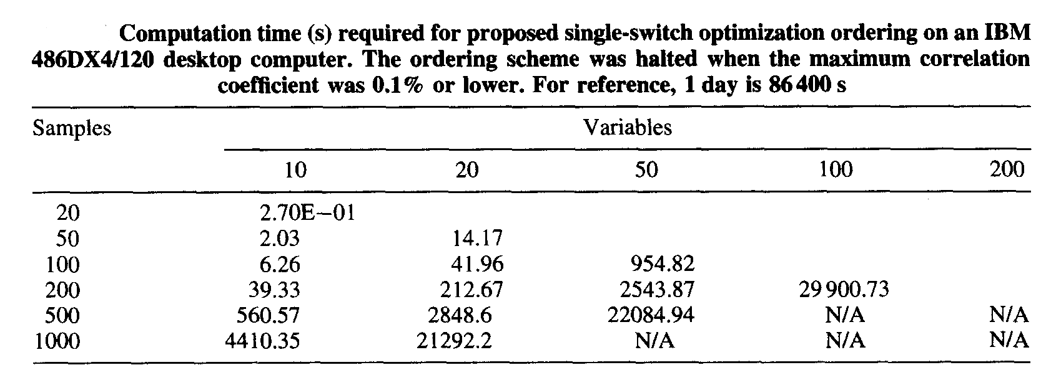
Sample Ordering
Updated Latin Hypercube ordering vs Single-switch optimization ordering
Source: D. E. Huntington, C. S. Lyrintzis. Improvements to and limitations of Latin hypercube sampling. 1998 San Diego State University, San Diego

Slide 25
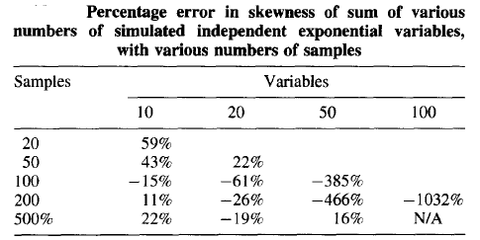
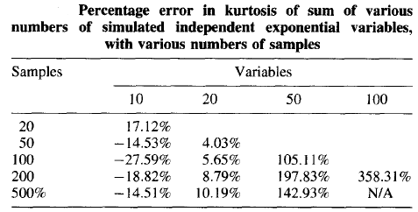
Poisson Process Simulation Results
Simulated mean for each variable is equal to its actual value
Variance of each variable is almost close to correct value
Error in skewness and kurtosis are large
Error in skewness increases as number of variables increase
More samples will not lead to more accurate result
Source: D. E. Huntington, C. S. Lyrintzis. Improvements to and limitations of Latin hypercube sampling. 1998 San Diego State University, San Diego

Slide 26
Poisson Process Simulation Results
Important Note:
Latin Hypercube can simulate uncorrelated variable but not independent
Monte Carlo simulation still used for independent variable

Slide 27
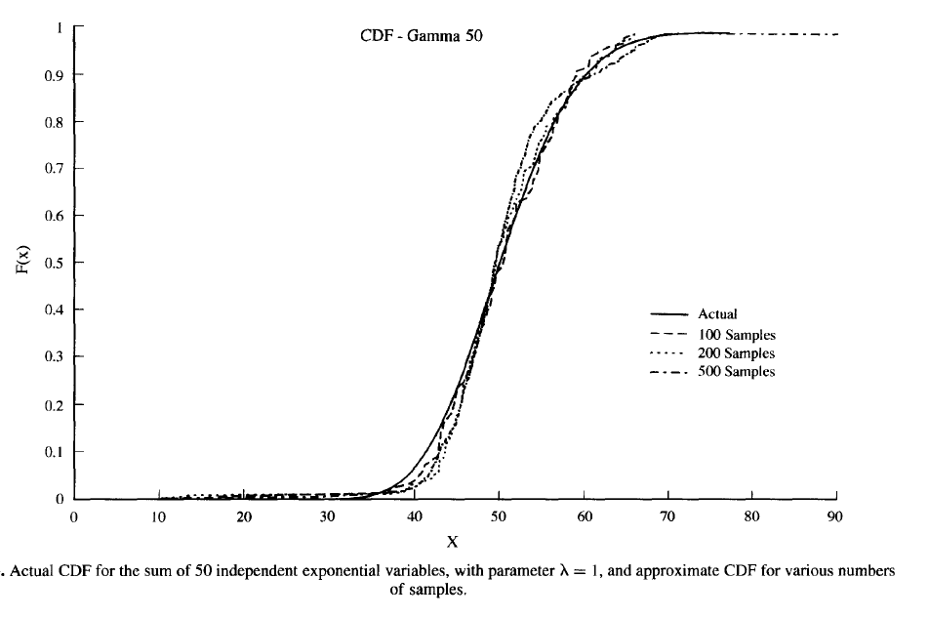
Poisson Process Simulation Results
Latin Hypercube sampling output can be used to create a cumulative distribution function( or CDF)
Sorted output values can be used as x-values , y-values being equally spaced
Simulated CDF results are roughly correct to the actual CDF
Source: D. E. Huntington, C. S. Lyrintzis. Improvements to and limitations of Latin hypercube sampling. 1998 San Diego State University, San Diego

Slide 28
Conclusion
Proposed sample generator provides better accuracy of simulated mean and variance of each variable
Optimized single-switch ordering improves target correlation between variables
Proposed improvements require higher computational time
Latin Hypercube not used to simulate independent variable
Future scope - develop new method for Latin Hypercube to simulate independent variable

Slide 29
Reference
[1]Shinozuka, M. & Jan, C. M. Digital simulation c random processes and its applications. Journal c
Sound and Vibration, 1972, 25, 111-128
[2]Shinozuka, M. & Deodatis, G. Simulation of stochastic processes by spectral representation. Applied, Mechanics Review, 1991, 44, 191-204.
[3]Florian, A. An efficient sampling scheme: update latin hypercube sampling. Probabilistic Engineering Mechanics, 1992, 7, 123-130.
[4]Moazzen, Iman. Latin Hypercube Sampling, 2016 , University of Victoria.

