Slide 1

Uncertainty quantification in machine learning
Disrupting Deep Uncertainty Estimation Without Harming Accuracy
Nidhi Patel (230199)
Mentored by: Chiara Balestra
Notes:
1

Slide 2
Outline
Motivation
Introducing ACE (Attacking Confidence Estimation)
Uncertainty estimation
Comparison: Advarserial attack Vs. ACE
Implementation of ACE
Effect of ACE
ACE under white-box vs. black-box settings
Summary and conclusions
Findings

Slide 3
Motivation
Why keep accuracy intact?
Adversarial attacks alter labels.
Affects the accuracy significantly.
Might alert the victim in case of constant monitoring.

Slide 4
Introducing ACE (Attacking Confidence Estimation)
Decreases the confidence of correct prediction.
Increases the confidence of incorrect prediction.
Does not alter the original prediction by the model to preserve accuracy.

Slide 5
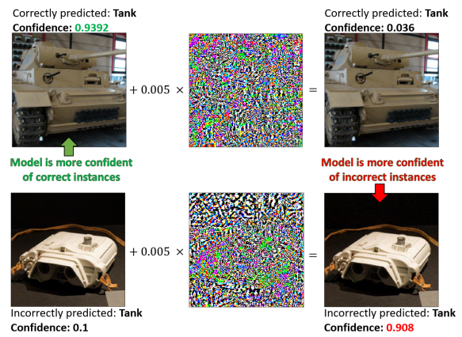
Demonstration of ACE on EfficientNet with softmax as the uncertainty estimation method.
Image source: Galil, Ido and El-Yaniv, Ran. 2021

Slide 6
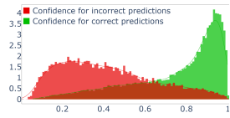
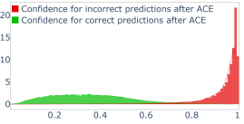
Confidence score ranks correct prediction higher than incorrect ones.
After ACE, confidence score ranks incorrect predictions higher and correct ones lower.
Image source: Galil, Ido and El-Yaniv, Ran. 2021

Slide 7
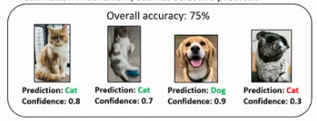
How does it work with respect to uncertainity estimation?
Risk-sensitive applications employ uncertainty estimation mechanisms like selective prediction.
Abstrains model from predicting observation with confidence lower than threshold.
Image source: Galil, Ido and El-Yaniv, Ran. 2021

Slide 8
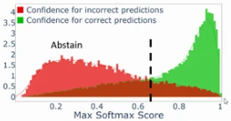
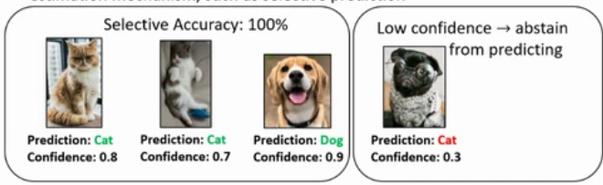
Applying selective prediction with 0.6 threshold value.
Image source: Galil, Ido and El-Yaniv, Ran. 2021

Slide 9
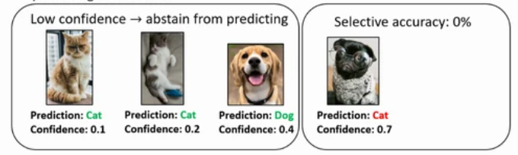
After attacking confidence estimation
Selective prediction abstains to predict the correct observations due to lower confidence.
predicts the majority of incorrect ones.
Image source: Galil, Ido and El-Yaniv, Ran. 2021

Slide 10
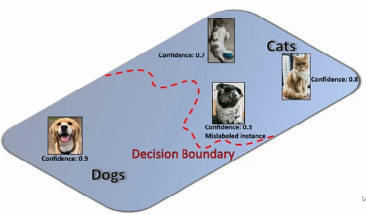
Comparison: ACE Vs. Adversarial attack w.r.t softmax function
Distance of instance from the decision boundary represents the confidence (softmax response).
Far away the instance from the decision boundary the more confident the model is about the prediction.
Image source: Galil, Ido and El-Yaniv, Ran. 2021

Slide 11
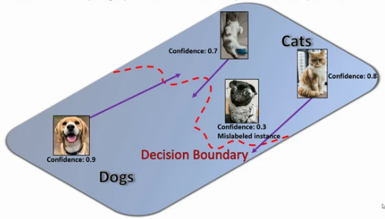
Standard advarserial attack
Must add perturbation large enough to push an instance across the boundary.
Larger the perturbation is more likely it is to be detected by the victim.
Image source: Galil, Ido and El-Yaniv, Ran. 2021

Slide 12
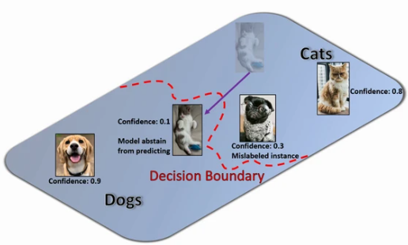
Adversarial examples might be assigned with lower confidence.
More likely to get rejected by selective prediction.
Image source: Galil, Ido and El-Yaniv, Ran. 2021

Slide 13
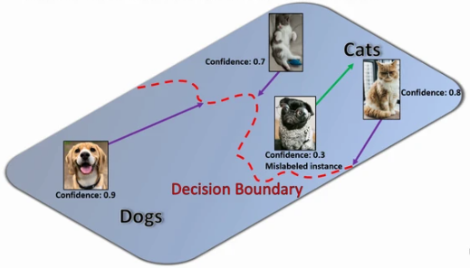
Attacking Confidence Estimation
ACE rather pushes the observation near the boundary.
The required amount of perturbation is significantly smaller than adversarial attack.
Image source: Galil, Ido and El-Yaniv, Ran. 2021

Slide 14
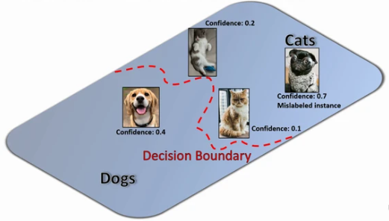
Targets model’s uncertainty estimation rather than accuracy.
Less likely to alert the victim.
Image source: Galil, Ido and El-Yaniv, Ran. 2021

Slide 15
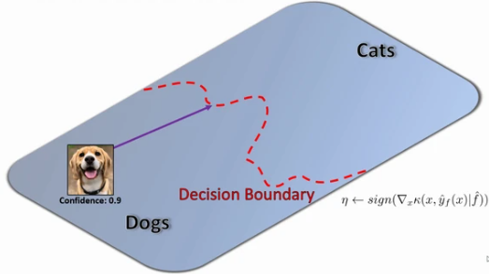
Implementation of ACE
Initialize the initial value of perturbation as Є
Єdecay as a rate of decay
Also, set the number of maximum iterations.
Image source: Galil, Ido and El-Yaniv, Ran. 2021

Slide 16
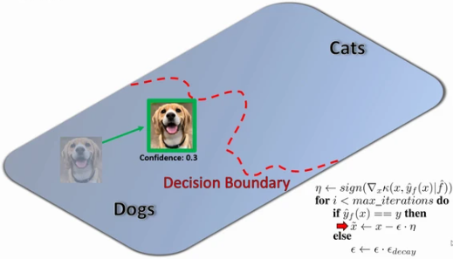
Craft a perturbation
Iteratively push the correctly predicted instances towards the boundary.
Image source: Galil, Ido and El-Yaniv, Ran. 2021

Slide 17
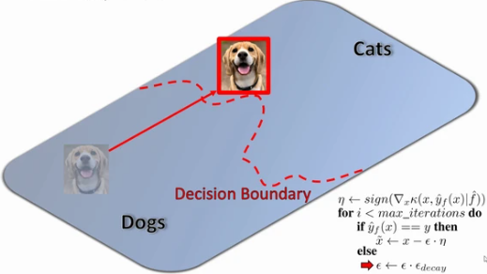
If the instance crosses the boundary, decrease the magnitude and try again.
If algorithm exceeds max_iterations, stop attacking.
Return the successfully perturbed instance within the boundary.
Image source: Galil, Ido and El-Yaniv, Ran. 2021

Slide 18
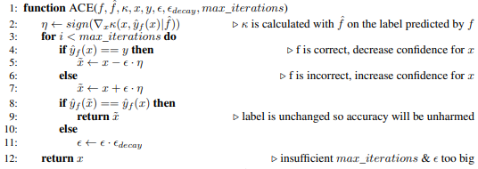


Algorithm
arguments:
f is the attacked model, is the proxy of attacked model f,(white-box settings, = f.) , κ is the confidence scoring function (softmax function), x is the input, y is the true label,
η is derivative of κ w.r.t. x

Slide 19
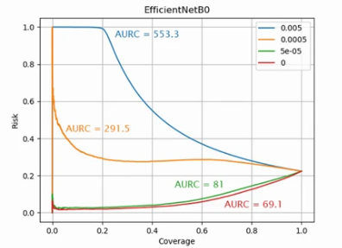
Effect of ACE
The Risk coverage curves of EfficientNet model under the white-box attack for different values of Є
For magnitude 0.005, the selective accuracy will be 0% for it’s top 20% most confident predictions.
Image source: Galil, Ido and El-Yaniv, Ran. 2021

Slide 20
ACE under white-box vs black-box settings
For white-box settings, much less perturbation (Є _effective ) is required compared to black-box to generate a similar amount of harm.
Є _effective value is the smallest Є for which maximum harm is caused without instance crossing the boundary.
The table containing observations for white box and black box attacks for different values of perturbations for ResNet50 .
 | Є | Є _effective | NLL | Brier Score | Accuracy
no | 0 | 0 | 0.963 | 0.336 | 76.01
White-box | 0.0005 | 0.000422 | 1.639 | 0.562 | 76.01
Black-box |  | 0.00046 | 1.308 | 0.474 | 76.01
White-box | 0.005 | 0.002245 | 3.237 | 0.718 | 76.01
Black-box |  | 0.003353 | 2.615 | 0.652 | 76.01

Slide 21
Summary and conclusions
ACE is a type of adversarial attack that targets the model’s uncertainty estimation performance rather than accuracy.
Benefits of ACE:
  The required perturbation is much less than that of an adversarial attack.
  Less likely to alert the victim.
  The success of ACE is not binary, even with a smaller magnitude of pertubation would succeed to create a considerable amount of harm.

Slide 22
Findings
Modifying ACE for the regression task:
              Uncertainty is measured by the variance of outputs.
              Attacking the variance of the outputs by causing an increase in variance of the inputs for which the model has the lower loss, and a decrease in variance for inputs for which the model had a high loss.
Suggestions for improvement:
      In ACE algorithm, optimize the perturbation in each iteration rather than when the instance crosses the boundary to increase efficiency.
      Criticism:
The paper contains no information about the defense mechanism to make the model robust to ACE.

Slide 23
References
Galil, Ido and El-Yaniv, Ran. (2021). Disrupting Deep Uncertainty Estimation Without Harming Accuracy.
https://slideslive.com/38968191/disrupting-deep-uncertainty-estimation-without-harming-accuracy
23

Slide 24
THANK YOU!

