Slide 1
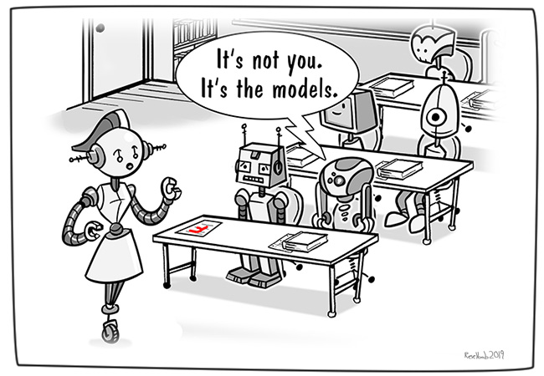

Sohith Dhavaleswarapu 24839
Adversarial Examples
and
Black- Box Attacks
Supervisor: Benedikt Böing

Slide 2

Motivation
Adversarial examples are fun toy for research…?
Or
A serious frailty in our models…?

Slide 3
Outline
Introduction
Neural Networks
What are Adversarial Examples?
Types of Adversarial Examples
Approach of generations
Transferability
Black box attacks
Real-world examples
Conclusions
References

Slide 4
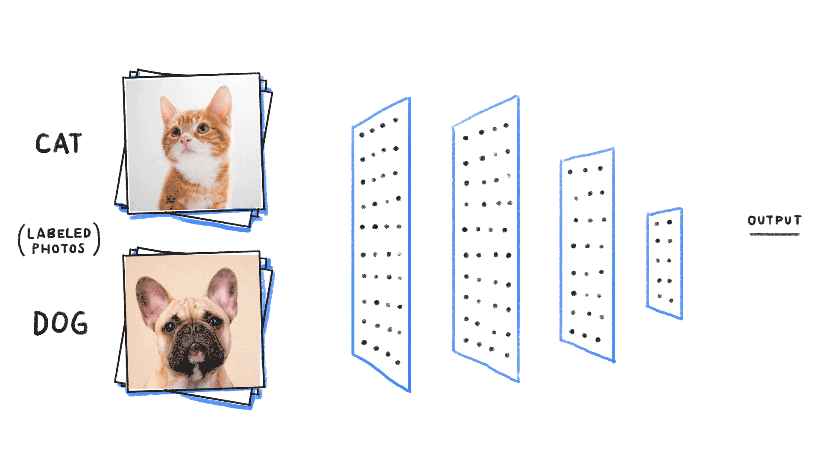
Introduction
Image classification can be performed by supervised machine learning algorithms like neural networks

Slide 5
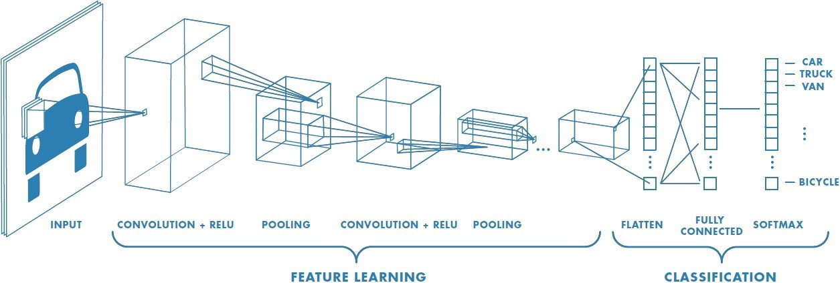
Neural Networks
What exactly our models are learning..?
Layers
Weights
Cost function
Gradient Descent
Back Propagation

Slide 6
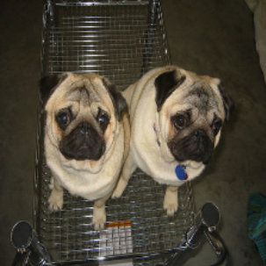

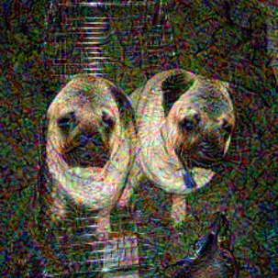
What are adversarial examples…?
Adversarial machine learning, a technique that attempts to fool deep neural network models with deceptive data
For a deep architecture, it is easy to generate adversarial examples, which are close to the original ones but are misclassified by the deep architecture
Original Image
perturbation
Adversarial example
+
=
True label : Pug,
Pug-dog
Resulted label: sea seal,
ocean, head, sea, cute

Slide 7
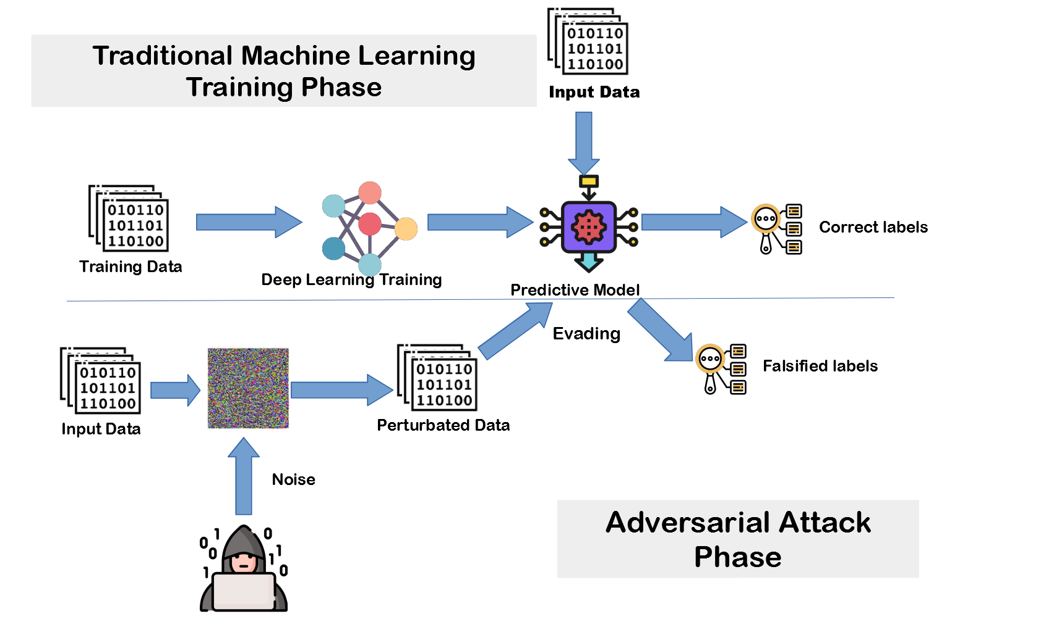
Adversarial Example

Slide 8
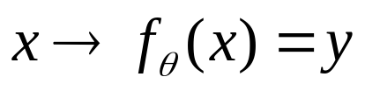









Types of adversarial examples
Non-targeted adversarial examples
Which can be misclassified by a network, regardless of what the misclassified labels may be!
Targeted adversarial examples
Which can be classified by a network as a target label
  - Original image
- Classifier
- Adversarial example
- Target label
- Target label specified by adversary

Slide 9




Approaches for generating Adversarial examples
Optimization-based approach
- Distance between an original image and its adversarial counterpart
- One-hot encoding of the ground truth label y
- Loss function to measure the distance between the prediction and the ground truth
- Model composed of a network J(x), which outputs the probability for each category
- Constant to balance constraints
Fast gradient sign
- Used to clip each dimension of x to the range of pixel values

Slide 10
Focus
Transferability
Adversarial examples generated for one model may also be misclassified by another model
This property has been exploited by constructing a substitute of the black-box model, and generating adversarial instances against the substitute to attack the black-box system

Slide 11
Measure of Transferability
Non targeted Transferability
Percentage of the adversarial examples generated for one model that can be classified correctly for the other. We refer to this percentage as accuracy. A lower accuracy means better non-targeted transferability.
Targeted Transferability
Percentage of the adversarial examples generated for one model that are classified as the target label by the other model. We refer to this percentage as matching rate. A higher matching rate means better targeted transferability.

Slide 12
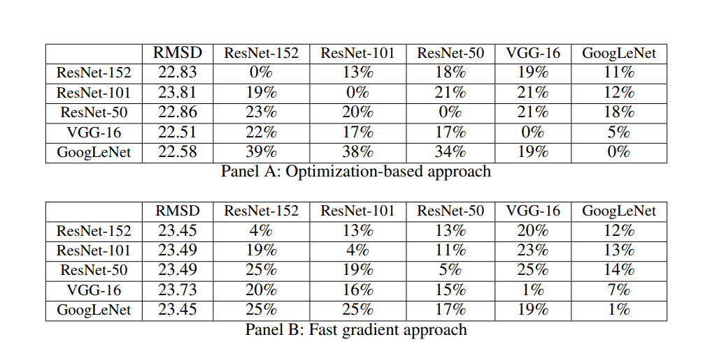
Non-targeted adversarial examples transfer
Transferability of non-targeted adversarial images generated between pairs of models.
RMSD(Root mean square deviation) – Measure of distortion

Slide 13
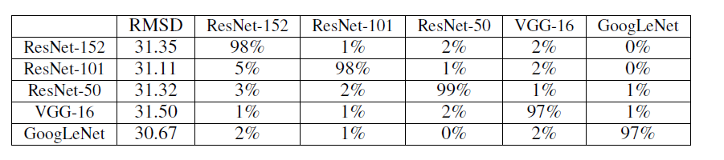
Targeted adversarial example transfer
The matching rate of targeted adversarial images generated using the optimization-based approach.
We observe that the target labels do not transfer among the models

Slide 14


ENSEMBLE-BASED APPROACHES
Problem: targeted adversarial examples generated using existing approaches almost never transfer with their target labels.
Solution: ensemble-based approaches to generating transferable adversarial examples
A hypothesis to prove adversarial image remains adversarial for multiple models, then it is more likely to transfer to other models as well
- an ensemble model
- An ensemble weights

Slide 15
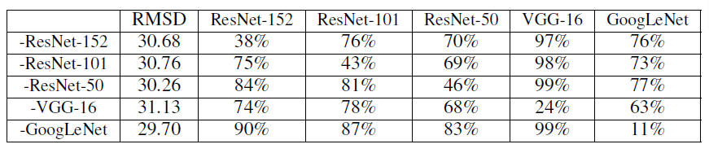
Results of ensemble based approach
The matching rate of targeted adversarial images generated using the ensemble-based approach.
Cell(i; j) indicates that matching rate of the targeted adversarial images generated for the ensemble of
four models except model i (row) is predicted as the target label by model j (column).
the minus sign “-” indicates that the model of the row is not used when generating the attacks

Slide 16
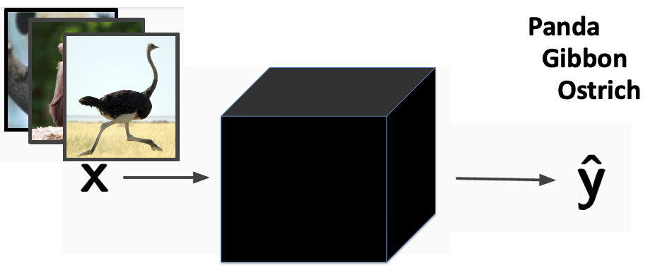
Black-box attacks
In the black-box attack scenario, the attacker has no information about the dataset and types of models used to train the model.
the only capability of the attacker is to input the chosen data to the target model and observe results labeled by the target model

Slide 17
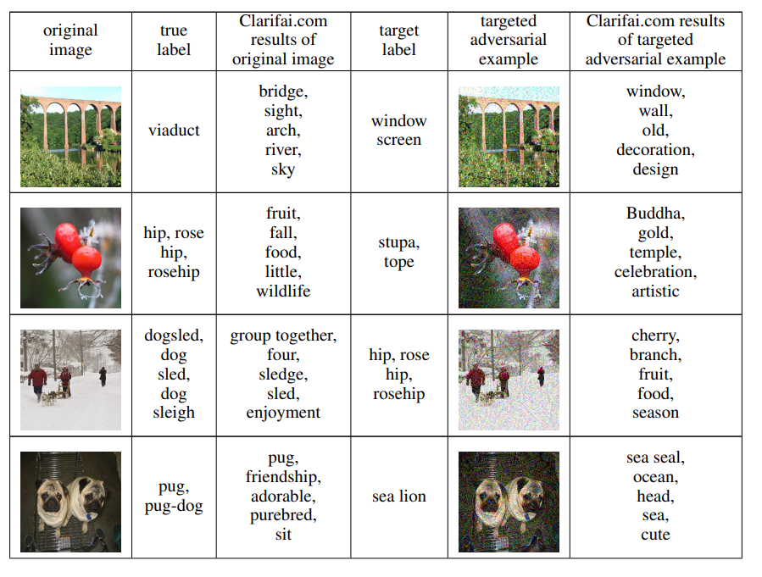
REAL WORLD EXAMPLE:

Slide 18
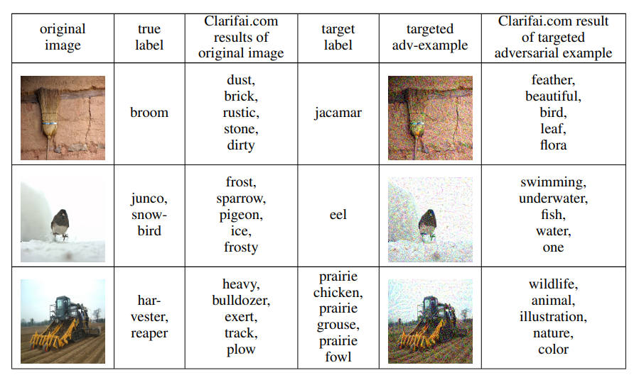
REAL WORLD EXAMPLE:

Slide 19
Conclusion
Observations:
The transferability for targeted and non-targeted adversarial example is prominent even for large models and a large-scale dataset.
It is hard to use existing approaches to generate targeted adversarial examples whose target labels can transfer.
Novel ensemble-based approaches demonstrate that they can generate transferable targeted adversarial examples with a high success rate.
Non-targeted and targeted adversarial examples generated using new approaches can successfully attack Clarifai.com, which is a black-box image classification system.

Slide 20
Conclusion
Findings:
The security community is gradually developing tools to build more robust ML models. More research has to be done. It is a very important factor in protecting your ML-powered applications against adversarial attacks.
Methods:
Adversarial training with perturbation or noise: It reduces classification errors
Ensemble adversarial learning: Multiple classifiers are trained together and combined to improve robustness

Slide 21
References
Liu, Yanpei & Chen, Xinyun & Liu, Chang & Song, Dawn. (2016). Delving into Transferable Adversarial Examples and Black-box Attacks.
P. Panda, I. Chakraborty and K. Roy, "Discretization Based Solutions for Secure Machine Learning Against Adversarial Attacks," in IEEE Access, vol. 7, pp. 70157-70168, 2019, doi: 10.1109/ACCESS.2019.2919463.
Goodfellow, Ian & Shlens, Jonathon & Szegedy, Christian. (2014). Explaining and Harnessing Adversarial Examples. arXiv 1412.6572.
https://towardsdatascience.com/hacking-neural-networks-2b9f461ffe0b
https://towardsdatascience.com/a-comprehensive-guide-to-convolutional-neural-networks-the-eli5-way-3bd2b1164a53

Slide 22

Thank you
&
Any Questions…?

