Slide 1
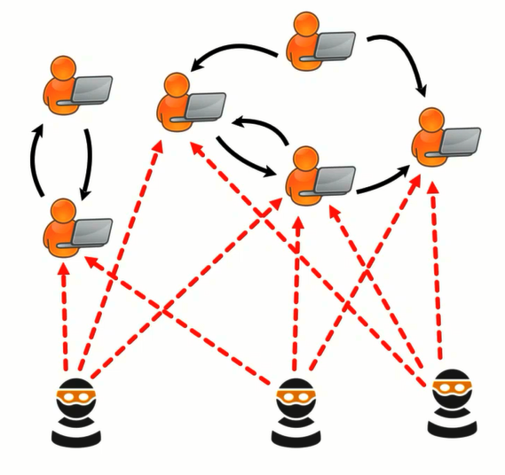
Graph Anomaly Detection with Deep Learning
Seminar Unsupervised Machine Learning
                Students: Hemani Chand and Jatin Rattan
                Supervisor: Simon Klüttermann

Slide 2
Table of Contents
Anomaly Detection
Graphs
Anomalous Node Detection
Anomalous Edge Detection
Anomalous Sub-Graph Detection
Anomalous Graph Detection
Future Scope and Conclusion

Slide 3
Anomaly Detection
Outliers, exceptions, peculiarities, rarities,
novelties etc
Source: https://static.tildacdn.com/tild3131-3237-4364-b662-663731666262/anomaly_detection.png

Slide 4
Applications
Fraud detection
Autonomous vehicle development
Network intrusion detection
Source: https://miro.medium.com/max/969/1*gVEGuKzXELsr7_0zTueHfQ.png,
https://www.deciso.com/wp-content/uploads/2015/11/Intrusion-detected-hr-900px-405x360.jpg
https://encrypted-tbn0.gstatic.com/images?q=tbn:ANd9GcTSZk9ykDoGRCb82Nz6hIozr2mw0Eqqfwcv9Q&usqp=CAU

Slide 5
Types of Anomalies
Point anomaly
Community anomaly
Contextual anomaly
Source: https://arxiv.org/pdf/1901.03407v2.pdf

Slide 6
Graphs
Types of graphs
Plain graph
G = {V,E}
Attributed graph
G = {V,E,X}
Dynamic graph
G = {V(t),E(t),Xv(t),Xe(t)}}
Source:https://miro.medium.com/max/1200/1*v_RunGMoLxaicBubSmKr1w.png
https://encrypted-tbn0.gstatic.com/images?q=tbn:ANd9GcSv_0qmlmmAHLSwDj6zmze25sN609-7Yh9q9Q&usqp=CAU
https://www.researchgate.net/profile/Jun-Luo-25/publication/220895154/figure/fig1/AS:654058415222789@1532951086640/The-model-of-social-networks-with-location-information-In-this-example-there-are-12.png

Slide 7
Challenges in
Graph Anomaly Detection
Data specific challenges (Data-CHs)
Scalability and dimensionality
Class imbalance and interdependencies
Technique specific challenges (Tech-CHs)
Noise and lack in labels
High training costs and interpretability

Slide 9
Anomalous Node Detection
ANOS ND on Plain Graphs
  Traditional non-deep learning techniques (OddBall)

Slide 10
Anomalous Node Detection
Network representation based techniques (Deepwalk, Node2Vec)

Slide 11
Autoencoder
Encoder
Latent space
Decoder
Source: https://ai-pool.com/a/s/understanding-autoencoders---an-unsupervised-learning-approach

Slide 12
ANOS ND on Attributed Graph
Deep NN Based Technique
Deep Outlier aware attributed Network Embedding (DONE)
Anomaly Score Assignment
Similar attributes
Connects
Different pattern

Slide 13
GCN Based Technique
Dominant

Slide 14
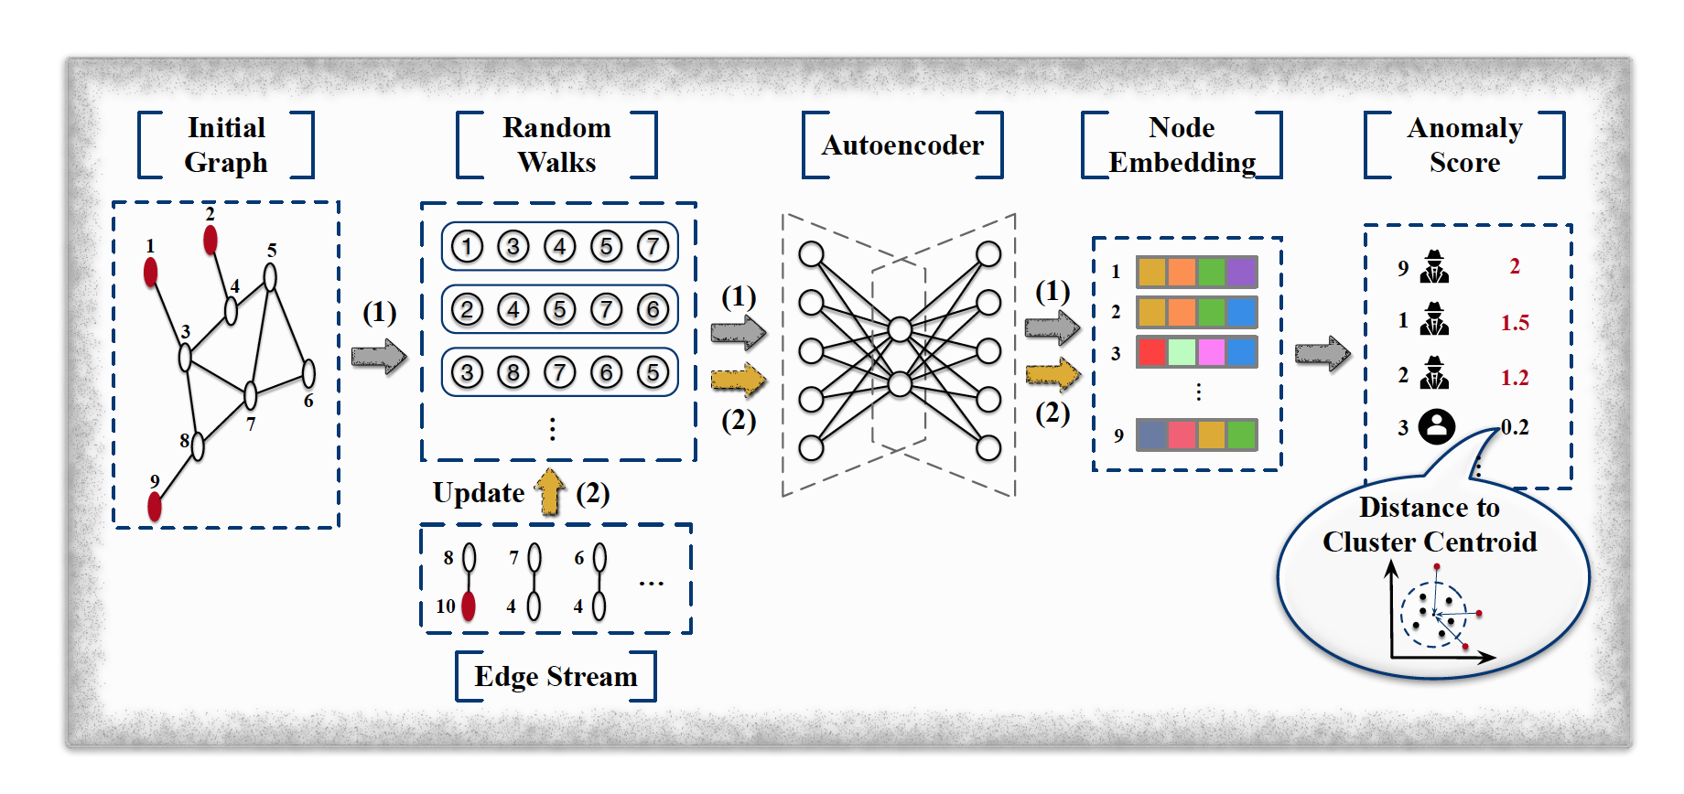
ANOS ND on Dynamic Graphs
Network Representation Based Technique (NetWalk)
Random walk sequences
Learning representations
Maintaining the network representations
Clustering based anomaly detection

Slide 15
Generative Adversarial Networks (GAN)
Generator
Discriminator

Slide 16
OCAN

Slide 17
ANOS ED on Static Graphs
Anomalous Edge Detection
Deep NN Based Technique
Unified Graph Embedding based anomalous edge Detection (UGED)
      Probability of each edge:
      Mean aggregation:

Slide 18
ANOS ED on Dynamic Graphs
GCN Based Technique (AddGraph)

Slide 19
Deep Learning Technique
Anomalous Sub-Graph Detection
Deep Fraud Detection (DeepFD)
Measures similarity:
User representations are trained using 3 losses
Reconstruction loss:
Similarity loss:
Regularisation loss:
Other methods under deep learning include FraudNE

Slide 20
GNN Based Technique
Anomalous Graph Detection
User Preference aware Fake news Detection (UPFD)

Slide 21
AD Performance Evaluation

Slide 22
Future Scope
Prior knowledge
Two pronged approach in dynamic graphs
Streaming heterogenous graphs
Imbalanced graph anomaly detection
Source: https://www.youtube.com/watch?v=lF11k2s1uWw

Slide 23
Conclusion

Slide 24

References
Ma, Xiaoxiao & Wu, Jia & Xue, Shan & Yang, Jian & Zhou, Chuan & Sheng, Quan & Xiong, Hui & Akoglu, Leman. (2021). A Comprehensive Survey on Graph Anomaly Detection with Deep Learning. IEEE Transactions on Knowledge and Data Engineering. 1-1. 10.1109/TKDE.2021.3118815
S. Bandyopadhyay, L. N, S. V. Vivek, and M. N. Murty, “Outlier resistant unsupervised deep architectures for attributed network embedding,” in Proc. ACM 13th Int. Conf. Web Search Data Mining, 2020, pp. 25–33
L. Ouyang, Y. Zhang and Y. Wang, "Unified Graph Embedding-Based Anomalous Edge Detection," 2020 International Joint Conference on Neural Networks (IJCNN), 2020, pp. 1-8, doi: 10.1109/IJCNN48605.2020.9206720
Y. Dou, K. Shu, C. Xia, P. S. Yu, and L. Sun, “User preference-aware fake news detection,” arXiv preprint arXiv:2104.12259, 2021.
Yoon, Minji & Hooi, Bryan & Shin, Kijung & Faloutsos, Christos. (2019). Fast and Accurate Anomaly Detection in Dynamic Graphs with a Two-Pronged Approach. 647-657. 10.1145/3292500.3330946

Slide 25
Thank you

